Slide 1

ENGINEERING CHEMISTRY
Asha A
Department of Science and Humanities

Slide 2

ENGINEERING CHEMISTRY
Module 5- Energy storage devices - Batteries
Class content:
Modern batteries
Zinc – air battery
Construction
Working
Advantages
Disadvantages
Applications
Lithium batteries
Lithium - ion battery
Construction
Working
Advantages
Disadvantages
Applications

Slide 3
ENGINEERING CHEMISTRY
Module 5- Energy Storage devices- Batteries
Modern batteries
Zinc air batteries
Metal-air battery
Anode : Zn ; Cathode : O₂
Alkaline battery ; electrolyte : alkali
Uses oxygen directly from the atmosphere to produce electrochemical energy
Cathode active material need not be stored inside the battery
Energy density is very high

Slide 4
ENGINEERING CHEMISTRY
Module 5- Energy Storage devices- Batteries
Construction:
Anode : Zinc granules with gelling agent ( to immobilize the composite and ensure adequate contact with Zinc granules) and a small amount of electrolyte
Cathode: Carbon (graphite) blended with MnO₂(catalyst) with a wet proofing agent coated on nickel wire mesh support and an outer layer of air permeable Teflon layer. Air access holes on the cathode provide pathway for O₂ to enter the battery
Electrolyte : 30% KOH
Separator : Polypropylene membrane soaked in electrolyte

Slide 5
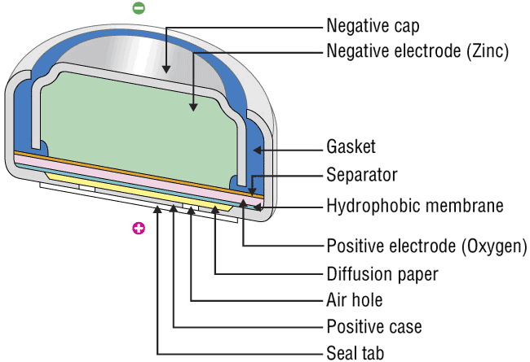
ENGINEERING CHEMISTRY
Module 5- Energy Storage devices- Batteries
Cross-section of Zn-air battery
Source:http://www.baj.or.jp/e/knowledge/structure.html

Slide 6
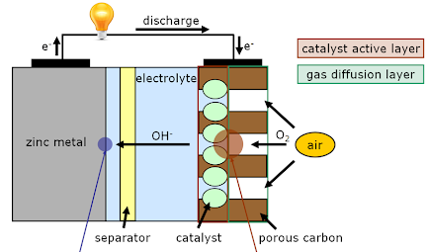
ENGINEERING CHEMISTRY
Module 5- Energy Storage devices- Batteries
Working:
Emf: 1.4 V
Source:http://www.kosekgroup.cz/equipment/zinc-air-battery/

Slide 7
ENGINEERING CHEMISTRY
Module 5- Energy Storage devices- Batteries
Advantages :
High energy density : Air is taken directly from atmosphere and need not be stored ; doesn't contribute to the mass of the battery
Very long shelf life : It can be kept sealed
No ecological problems
Low cost
Disadvantages :
Limited power output
Along with air, CO₂ may enter the battery. It reacts with
KOH to from K₂CO₃ , which will reduce the efficiency
CO₂ + 2KOH → K₂CO₃ + H₂O

Slide 8
ENGINEERING CHEMISTRY
Module 5- Energy Storage devices- Batteries
Applications :
As power source in hearing aids
In various medical devices
In voice transmitters
Large zinc-air batteries are used in rail-road signaling

Slide 9
ENGINEERING CHEMISTRY
Module 5- Energy Storage devices- Batteries
Lithium batteries
Lithium is a popular anodic material:
Light weight metal. The electrochemical equivalence of lithium is high (7g of lithium can give 1F of charge)
High negative standard reduction potential of -3.05V ; when coupled with other electrodes gives high voltage
( about 4V)
Aqueous electrolytes cannot be used as Lithium is very reactive and it reacts vigorously with water . So organic and inorganic electrolytes are used

Slide 10
ENGINEERING CHEMISTRY
Module 5- Energy Storage devices- Batteries
Components of Lithium batteries: Lithium is used as anode; Cathode can be MnO₂, SO₂Cl_{2.} Electrolyte can be Li salt in organic solvents like acetonitrile, propylene carbonate or inorganic solvents like SOCl₂
Types of Lithium batteries :
Primary batteries which are not rechargeable, e.g. Li-MnO₂
Secondary batteries which are rechargeable, e.g. Li-ion battery

Slide 11
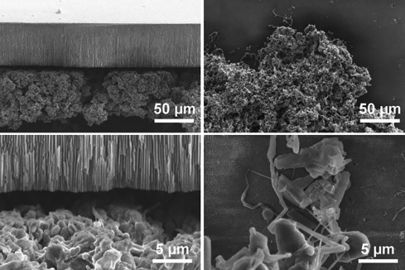
ENGINEERING CHEMISTRY
Module 5- Energy Storage devices- Batteries
Advantages of lithium batteries
High Voltage up to 4V
High energy density – Lightest metal
High tolerance to service conditions (-40 ºC to 70 ºC)
High electricity storage density
Flat discharge characteristics
Disadvantages of lithium batteries
Safety concerns due to high reactivity of Lithium metal
Poor cycle life – due to dendrite formation
Transportation limit

Slide 12
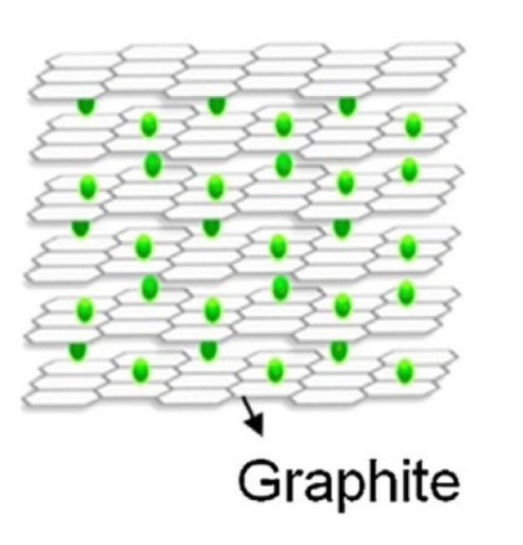
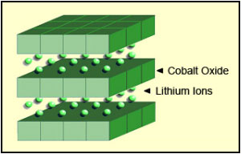
ENGINEERING CHEMISTRY
Module 5- Energy Storage devices- Batteries
Lithium ion battery
Principle :
Lithium ion moves from anode to cathode while discharging and from
cathode to anode while charging
Materials used as anode and cathode should be capable of lodging
Lithium ions
Anode material: Lithiated graphite Cathodic material : LiCoO₂
Source:https://www.jecst.org/journal/view.php?number=335&viewtype=pubreader
Source:https://batteryuniversity.com/learn/article/types_of_lithium_ion

Slide 13
ENGINEERING CHEMISTRY
Module 5- Energy Storage devices- Batteries
Lithium ion battery
Construction:
Anode: Lithiated -Carbon (Graphite) coated on Copper current collector
Cathode: Lithiated transition metal oxide coated on Aluminium current collector e.g. Lithium cobalt oxide(LiCoO₂)
Electrolyte: The electrolyte is typically a mixture of organic carbonate solvents such as ethylene carbonate or diethyl carbonate containing lithium salts like LiPF₆, LiClO₄
Separator: It is a very thin sheet of micro perforated polypropylene membrane

Slide 14
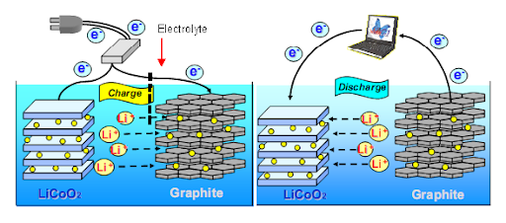
ENGINEERING CHEMISTRY
Module 5- Energy Storage devices- Batteries
Working:
Charging Discharging
Source:http://www.ee.ui.ac.id/epes/research-group/energy-materials

Slide 15
ENGINEERING CHEMISTRY
Module 5- Energy Storage devices- Batteries
Reactions:
During Charging:
At Anode: LiCoO₂ → Li_{(1-x)}CoO₂ + xLi⁺ + xe⁻
At Cathode: xLi⁺ + xe⁻ + xC₆ → xLiC₆
LiCoO₂+ xC₆ → Li_{(1-x)}CoO₂ + xLiC₆

Slide 16
ENGINEERING CHEMISTRY
Module 5- Energy Storage devices- Batteries
Advantages :
Lighter than other rechargeable batteries for a given capacity
Li-ion chemistry delivers a high open-circuit voltage 3.7 V
Low self-discharge rate
Do not suffer from battery memory effect
Good cycle life as the problem of dendrite formation is eliminated (at no point, neither charging nor discharging, Lithium metal is formed)
Disadvantages :
Rising internal resistance with cycling and age
Safety concerns if overheated or overcharged

Slide 17
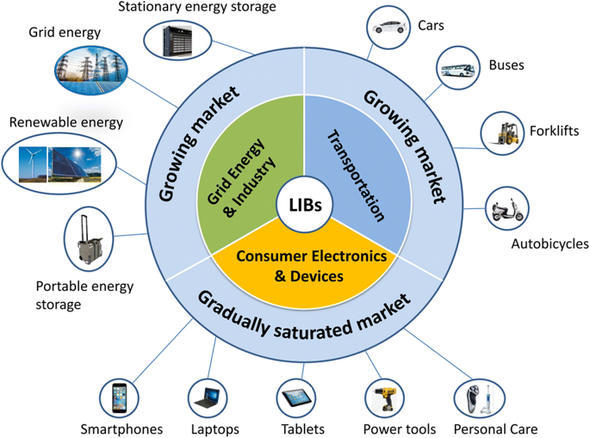
ENGINEERING CHEMISTRY
Module 5- Energy Storage devices- Batteries
Source:Ding, Y. et al. Electrochem. Energ. Rev. 2, 1–28 (2019).

Slide 18
ENGINEERING CHEMISTRY
Module 5- Energy Storage devices- Batteries
Latest materials in use :
Lithium Nickel Cobalt Aluminum Oxide (LiNiCoAlO₂)
Lithium Nickel Manganese Cobalt Oxide (LiNiMnCoO₂) - Panasonic and Tesla
Lithium Titanate (Li₂TiO₃) - As anode; LiMnO₂ as cathode

Slide 19
THANK YOU
Asha A
Department of Science and Humanities

